Slide 2
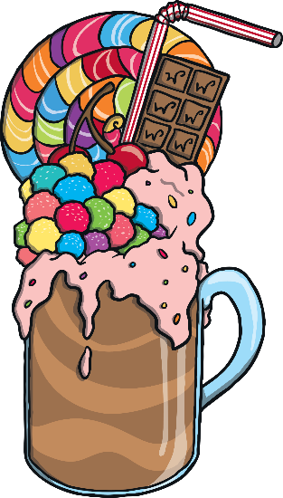
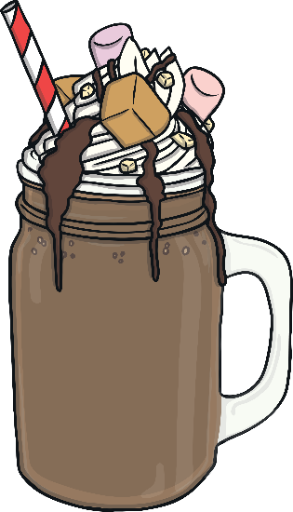
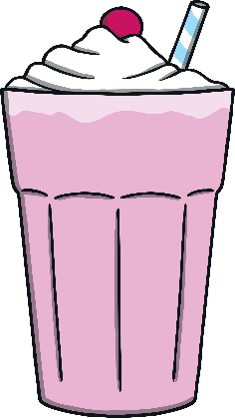
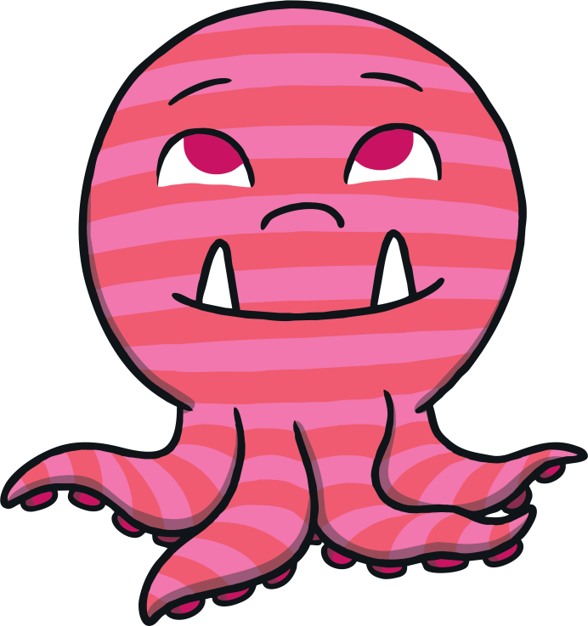
The Cafe Is Open
Monsters just love milkshakes! They drink them all day long. Let’s see which milkshakes the monsters have been drinking at the cafe today.
Yum yum! Which delicious milkshake shall I order today?
Which one would you order?

Slide 3
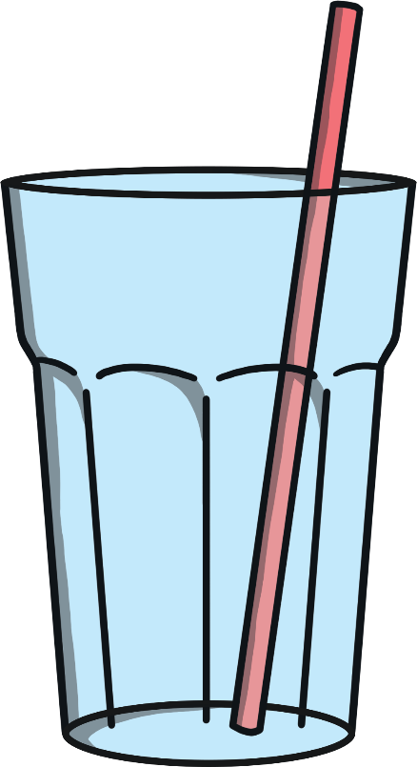
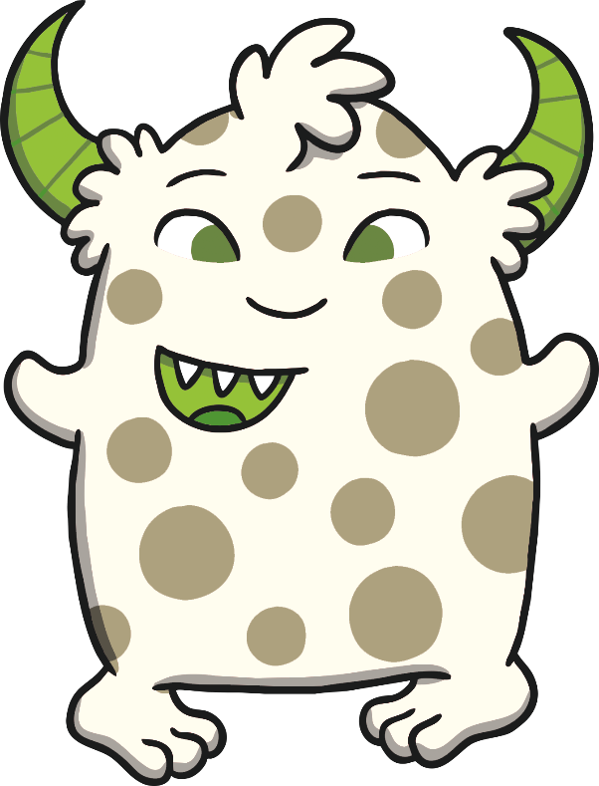
Milkshake Mix Up!
The monsters have mixed up their milkshakes. Can you help them to find which milkshake is theirs?
Hello! My favourite milkshake is chocolate. My milkshake is full. I wonder which one is mine.
Well done! You found my milkshake. My milkshake is full.

Slide 4
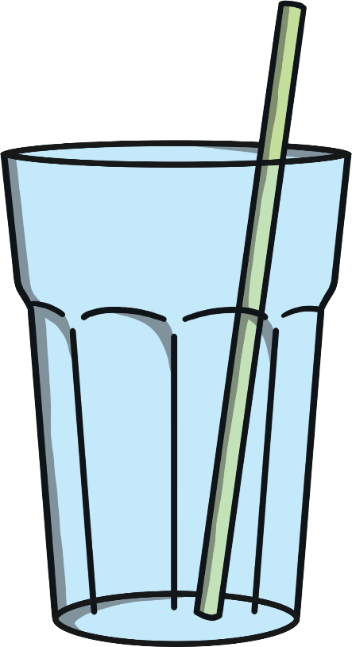
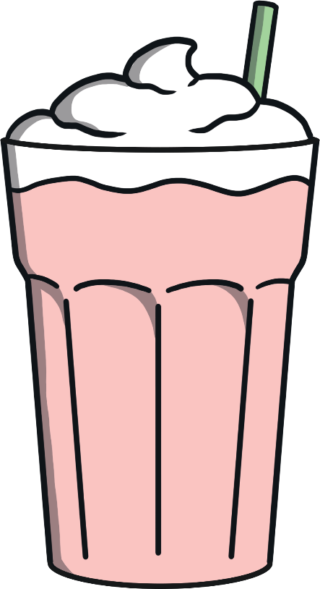
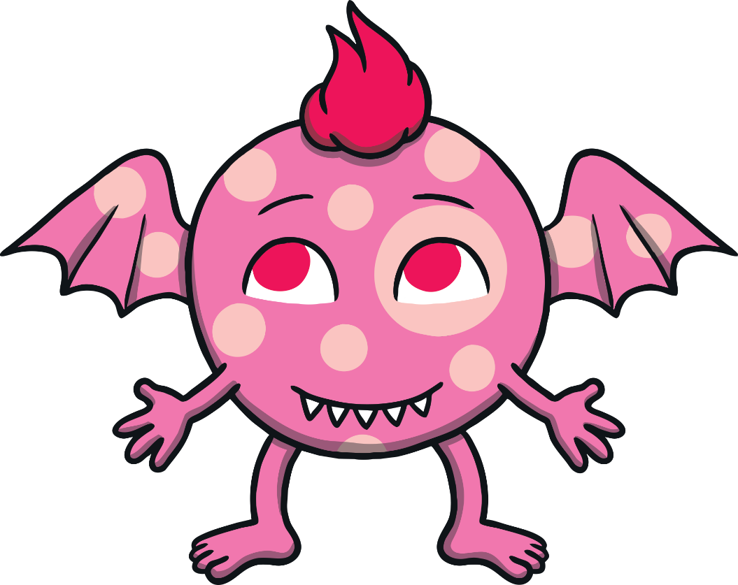
I love strawberry milkshakes so much that I have drunk all of mine! My milkshake is empty. Which glass is mine?
Great job! My milkshake is empty. I need to buy another one!

Slide 5
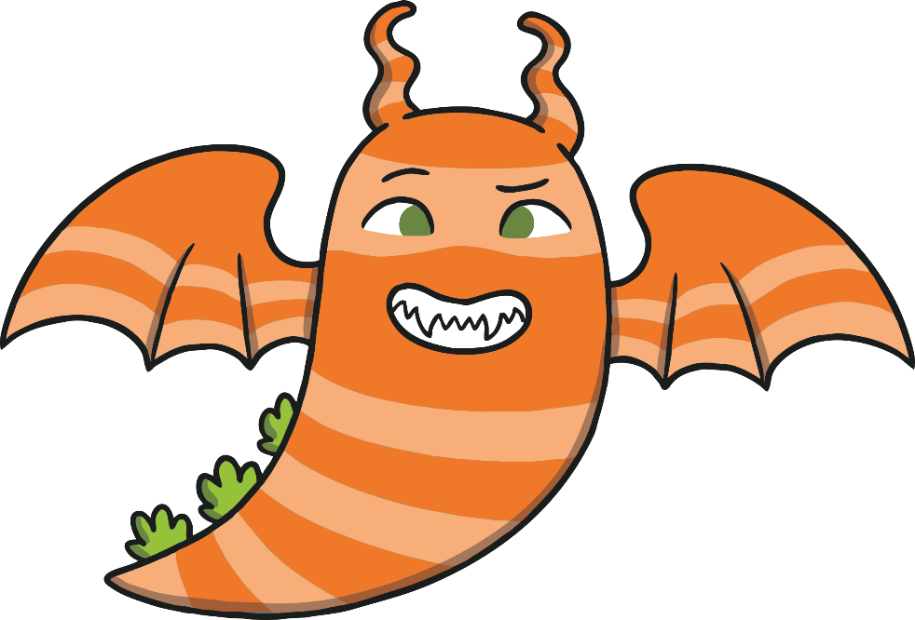
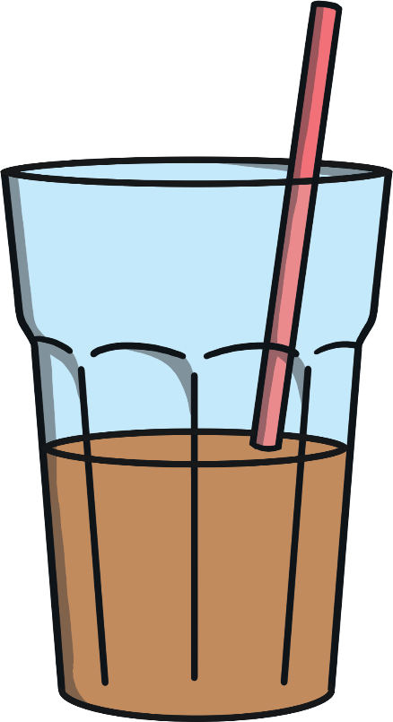
I’m not sure which milkshake is mine. I have drunk some of my milkshake. My milkshake is half full.
Can you find it?
Thank you for finding my milkshake. My milkshake is half full.

Slide 6
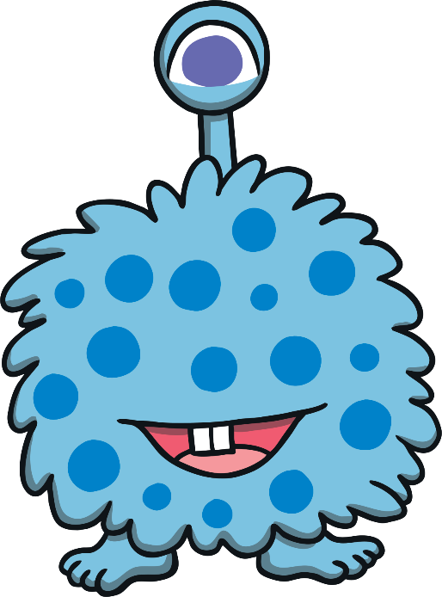
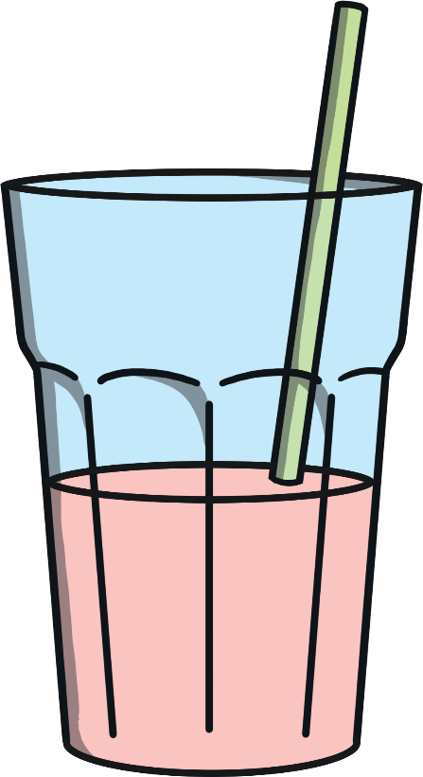
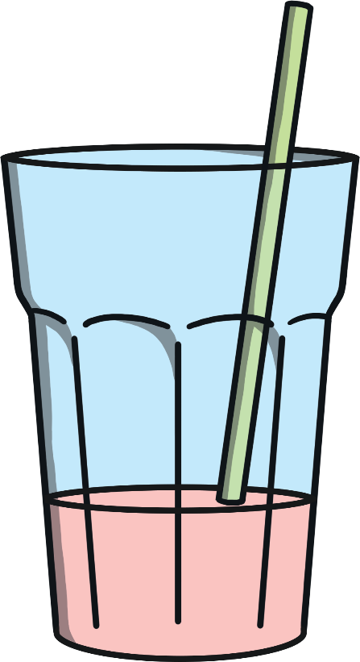
I have nearly finished my milkshake. My milkshake is nearly empty. I wonder which one is mine.
Yes, that’s my milkshake. My milkshake is nearly empty.

Slide 7
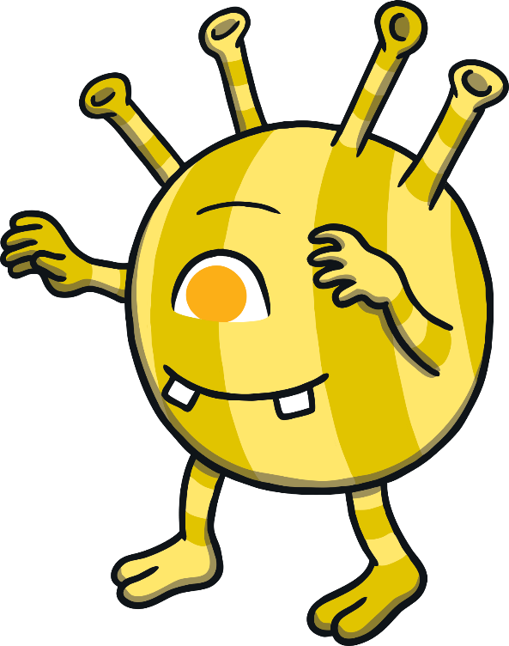
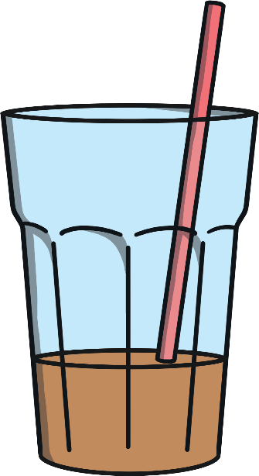
I drink my milkshake very slowly. My milkshake is nearly full. Which milkshake is mine?
Super! I have only had a little bit of my drink. My milkshake is nearly full.

Slide 8
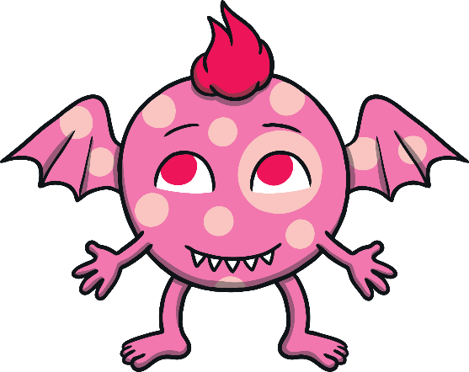
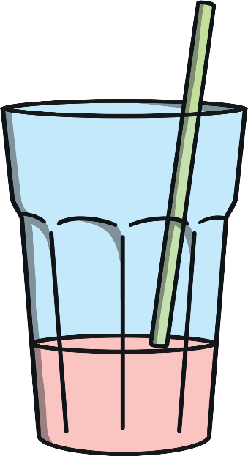
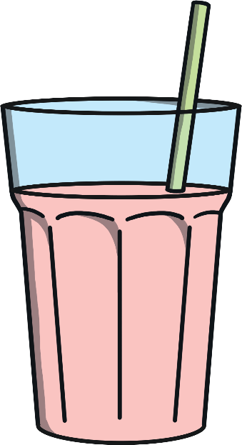
Oh no! They have mixed them up again.
My milkshake has the most. Which one is mine?
My milkshake has the least. Which one is mine?
Talk about which milkshake has the most and the least. When you are ready, click on me

Slide 9
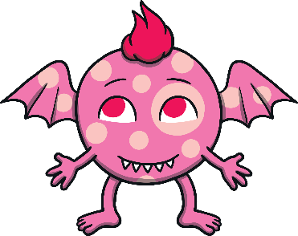
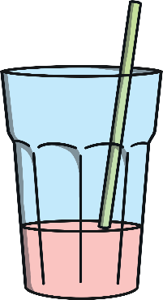
Thank you for helping the monsters with their milkshake mix up.
full
nearly full
half full
nearly empty
empty

